Slide 1



Introducing Majisemi: 'Seri ous' B2B marketing suppor t starting with webinars
For those considering Majisemi for the first time
Seminars strong in attracting attendees
No.1
Seminars strong in acquiring new business negotiations
No.1
Seminars chosen by IT managers
No.1
Survey by Japan Marketing Research Organization Overview: 2021 Service Comparison Impression Survey

Slide 2
Introduction
Purpose of today's meeting
For companies considering "Majisemi" for the first time, we will discuss the following topics.
Hearing about marketing challenges
How to utilize Majisemi?
©2018 MAJISEMI Inc.

Slide 3
ヒアリング
©2018 MAJISEMI Inc.

Slide 4
ヒアリング
Issue Identification
■ About the products you want to introduce in the seminar
・Which product or service?
・Who is the target audience (people you want to invite to the seminar)?
・Industry, company size, department, position, etc.
※ Majisemi specializes in "IT departments, DX departments, security departments across all industries, and production/manufacturing departments in factories"
・What are the competing products?
・What are the strengths and differentiation points compared to competing products?
©2018 MAJISEMI Inc.

Slide 5
ヒアリング
Issue Identification
■ On the necessity of seminars (webinars)
・What is considered important as a means of lead acquisition?
・Seminars (webinars)
・Websites (content marketing)
・リアル展示会
・比較サイト
・GoogleやFacebookなどへの広告
・テレアポ
・その他
■予算の状況
・リード獲得単価、アポ獲得単価
・セミナー（ウェビナー）の予算の有無、及び金額
・上記リード獲得手段の予算の割合
・予算の策定、決定時期
©2018 MAJISEMI Inc.

Slide 6
ヒアリング
Issue Identification
■セミナー（ウェビナー）の目的／課題
・より多くのリードを獲得したい／集客できない
・ターゲットに合ったリードを獲得したい／リードの質が悪い
・ウェビナーから商談につなげたい／商談につながらない
・ウェビナーの運営を代行してほしい／運営が大変
・まずはスモールスタートでウェビナーをやってみたい
・その他
・ウェビナーを活用した、東南アジアにおける新規顧客開拓やテストマーケティング
©2018 MAJISEMI Inc.

Slide 7
なぜ「ウェビナー」なのか？
©2018 MAJISEMI Inc.

Slide 8
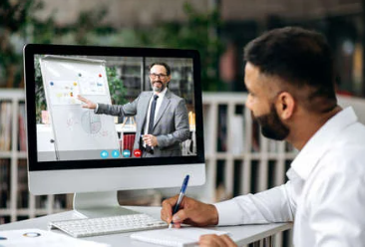

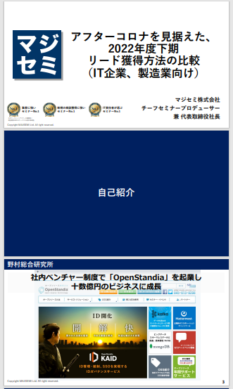
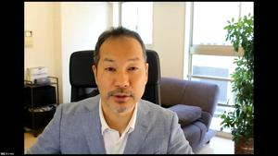
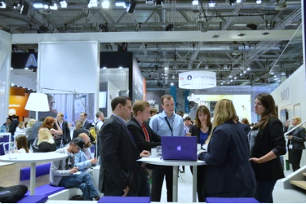
BtoBマーケティングにおけるウェビナーの役割
Webinar
as a Service
Lead acquisition
Lead Nurturing
Proposal & Order
課題に
気づいてない
課題に気づき
社内で検討
製品・サービスの
候補を捜す
製品・サービスを絞って
評価・選定、稟議
課題に気づかせる
課題について深く理解させ、
解決方法を提示する
競合よりもお客様に早く接触し、課題解決をサポートする
数社～十数者程度の検討の候補に入り、２～３社の最終候補に残る
２～３社の最終候補から自社を選んでもらう
Utilization of Webinar Content
課題に気づかせる。
課題について深く理解させる。
競合よりもお客様に先に接触し、自社を知ってもらう。
When hosting a webinar,
a lot of content is generated
● Presentation materials → White Paper
● Presentation video → YouTube, Social Media
● Presentation content → SEO articles, Blog
Webinar
Field Sales
Webサイト
Content Marketing
Webinar
Social Media Advertising
Deepen understanding of challenges.
Also provide competitive comparison information and information about our products.
For nurturing existing leads.
リアル展示会
オンラインイベント
Download Materials
Field Sales
©2018 MAJISEMI Inc.

Slide 9

Email Advertising
Positioning of Webinars in Lead Acquisition
planning
Cost per Lead
Telemarketing
¥30,000
Webinar
リアル展示会
Listing/Social Media Advertising
Visitor
14,500 yen
Majisemi
Club
¥10,000～
¥10,000
Online
Exhibition
(Large-scale Webinar)
Comparison Sites
Download Materials
On-Demand
Video Distribution
¥5,000
リアル展示会
Joint exhibition
Low
Interest
High
©2018 MAJISEMI Inc.

Slide 10
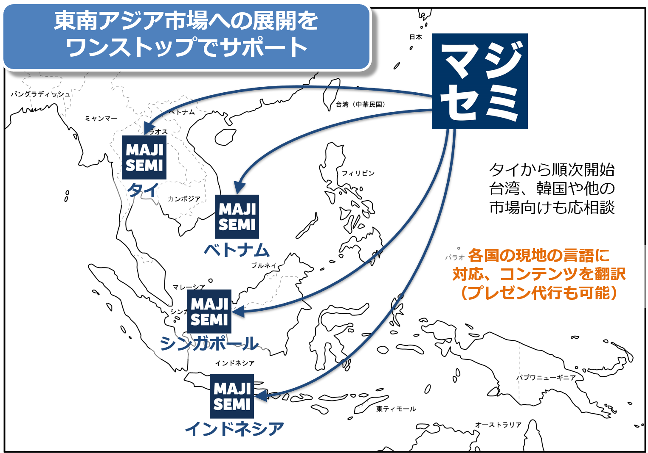
Support for expanding into Southeast Asia using webinars
planning
Webinars can be delivered to Southeast Asia at almost the same price as for Japan.
Your company only needs to prepare a presentation video (plus slides) in Japanese (or English).
Majisemi handles everything from adding subtitles in local languages, translating slides, to the day of delivery.
Options include follow-up after the webinar and secondary use of webinar videos with local language support.
Promoting joint exhibition at trade shows held in Southeast Asia.
©2018 MAJISEMI Inc.

Slide 11


Why start with webinars?
planning
Cold calls or direct mail from no prior contact can lead to distrust.
First, by hosting a webinar that 'provides valuable information', you can establish the initial contact and
gain 'trust and credibility'.
Features of webinars
When emailing the entire list
Can provide an 'interactive experience'
Live Q&A
Demos and factory tours while receiving questions and requests
Can obtain 'live feedback'
Pre/post surveys, as well as polls and questions during the presentation
Can attract 'highly interested' viewers
In small webinars, people troubled by issues your products/services can solve participate
Build trust by 'sharing the space'
Recognized as a 'teacher'
Building trust through communication like Q&A
0.7%
70%
The response rate when sending materials via email
is about 100 times!
When emailing seminar participants
Face-to-face communication with customers
can enhance trust and credibility
The response to follow-up
is approximately 100 times different
*According to our research
©2018 MAJISEMI Inc.

Slide 12
Overview of Majisemi's services
©2018 MAJISEMI Inc.

Slide 13
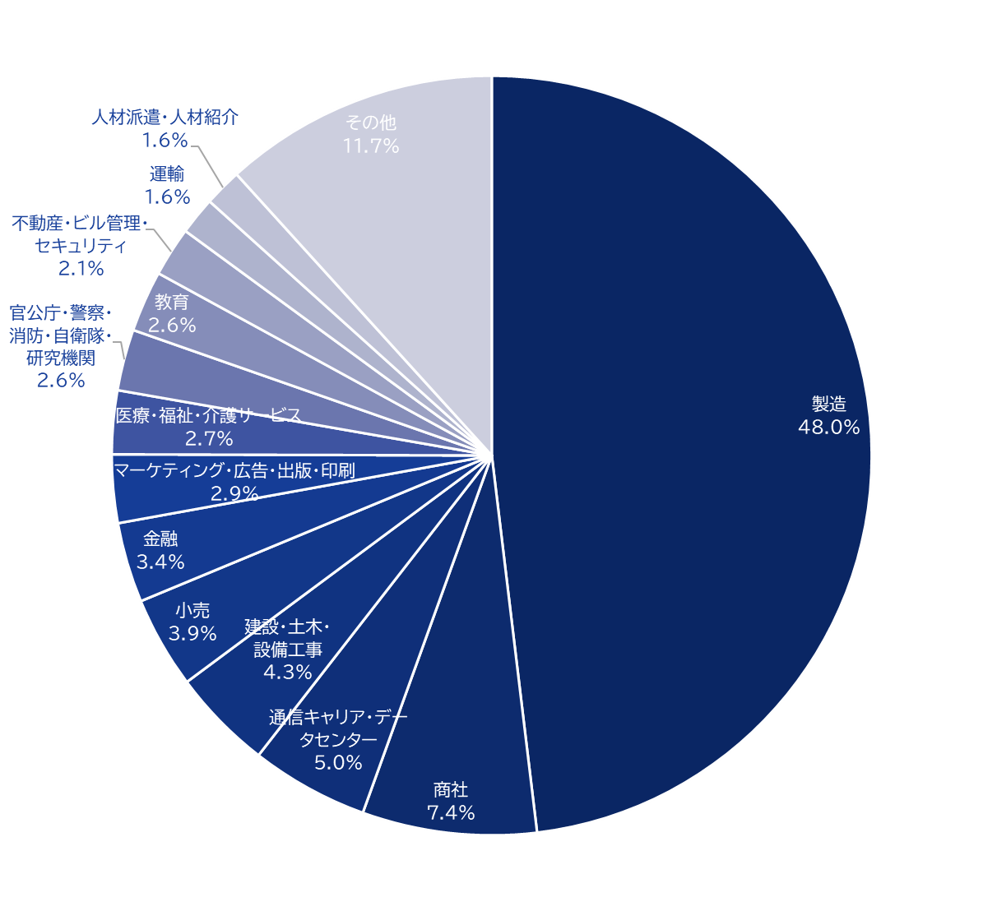
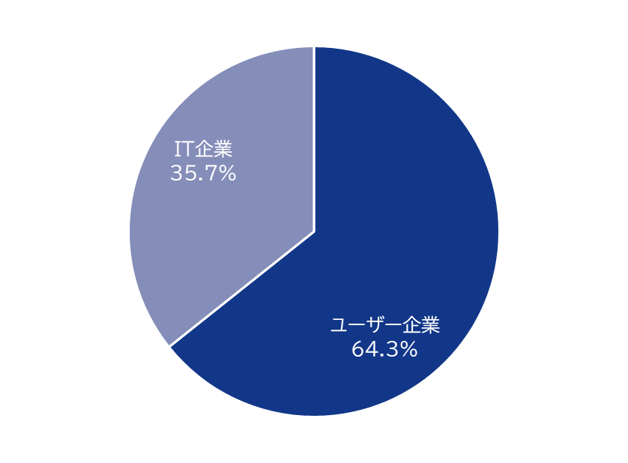
Majisemi's house list
Webinar
as a Service
Attracting power
Possessing approximately 250,000
house list entries!
Breakdown of user companies
House
List
Overall
*Estimated from seminar applicants from 2020 to 2024
©2018 MAJISEMI Inc.

Slide 14
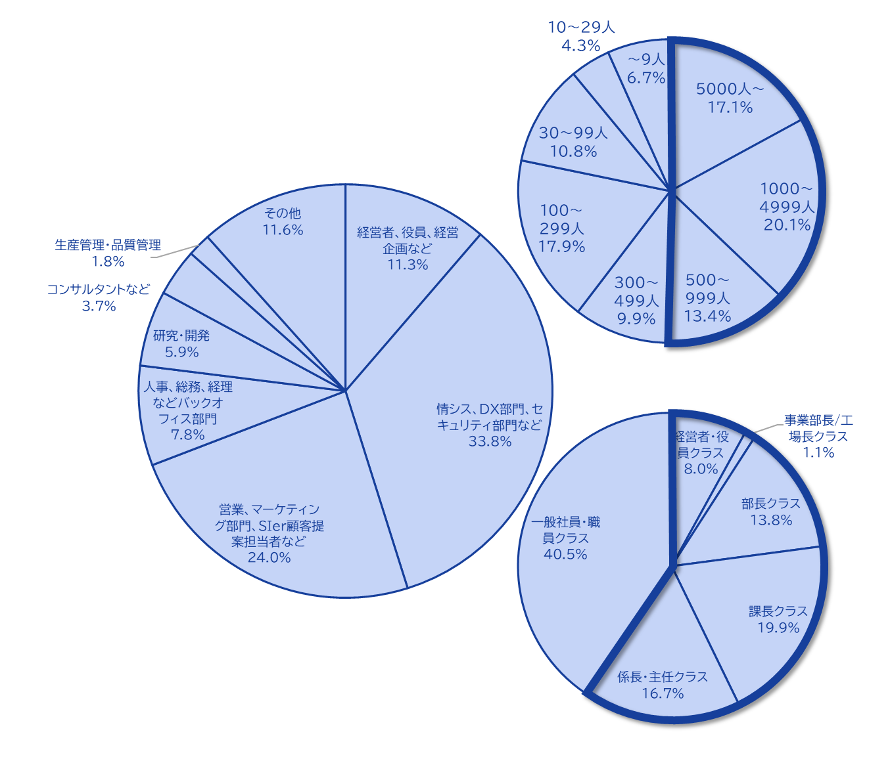
Majisemi's house list
Webinar
as a Service
The Majisemi list is
almost exclusively focused on the following attributes.
Nearly half work at
large enterprises
Company
Size
All industries × Information Systems Department, DX-related Department
All industries × Security Department
Manufacturing × Production/Manufacturing Department
All industries × Back Office Department
IT Companies × All Job Functions
Job function
Breakdown of house list
At Majisemi, to ensure that more individuals who match your company's products and services participate in the webinar, instead of using attribute specification (segmentation) for gathering participants via email,
we design the webinar theme (title, announcement text)
on behalf of Majisemi,
adopting a method to increase the proportion of your target audience.
Emails are not sent to all entries, but prioritized for those highly interested in the set theme.
Position
Primarily managers
©2018 MAJISEMI Inc.

Slide 15





Why is it necessary to hold webinars?
Webinar
as a Service
The value of cold leads and the importance of repeating webinars
Lead acquisition
Nurturing & Business Negotiations
Contract
1 individual
Hot leads
3 people
Seminar held
30 participants
Cold lead
21 individuals
Repeatedly held
is important!
27 individuals
Including past participants, repeatedly holding webinars
to efficiently acquire new leads and nurture them.
If left unattended
21 individuals
80% sign contracts with
competitors within 2 years
Majisemi conducts long-term follow-ups with past participants,
and also offers 'MajiFollow Plus' to assist in appointment acquisition.
(SiriusDecision survey)
©2018 MAJISEMI Inc.

Slide 16








Reasons to use Majisemi
Webinar
as a Service
Delegate your webinar operations to us
Repeat PDCA to explore winning patterns
Planning
Attracting attendees
Seminar
Secretariat
Moderation
Appointment acquisition
(Optional)
Survey aggregation
Report creation
SEO article creation
Video production
(Optional)
Review &
Improvement
One-stop service from
start to finish
Majisemi handles it all, so
All support included
with only the cost of attracting attendees!
Focus on the presentation
on the day!
©2018 MAJISEMI Inc.

Slide 17

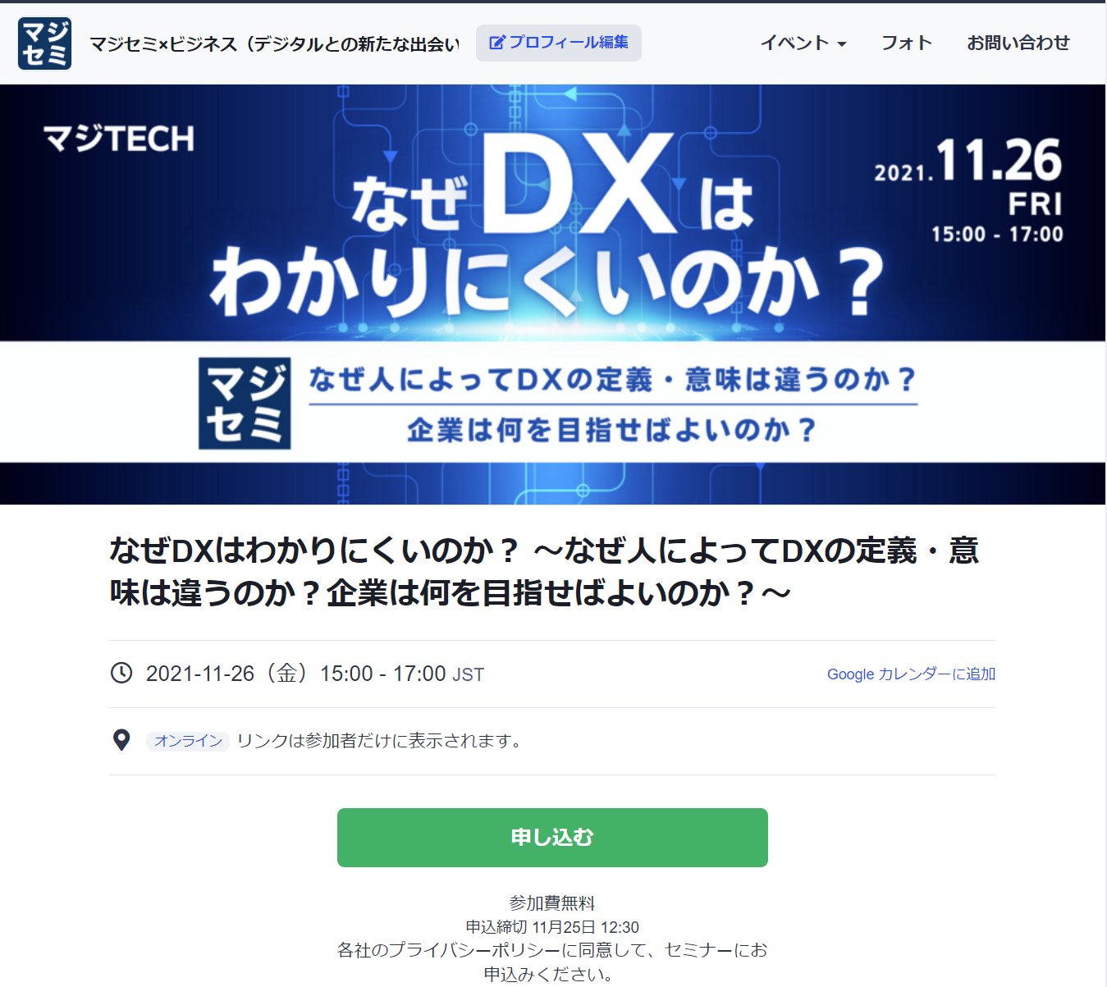
Reasons to use Majisemi
Webinar
as a Service
In a single webinar, it is possible to acquire new leads and nurture existing leads simultaneously
Creation and publication of attendee pages
Attracting attendees
Majisemi management screen
Reminder distribution 1 week before & the day before
Majisemi attendee slots
Attracting customers with Majisemi
Majisemi slot
Applicant data
Distribution of participation URL
Plan finalized
To your company's customer acquisition slot
Applications are
not subject to charges regardless of the number!
Utilize your existing
house list nurturing,
reviving dormant customers,
and acquiring new leads through your website, etc.
Please make full use of it!
Your attendee slots
After publication
URL
provided
Attract customers through your company's house list, website, etc.
Your attendee slots
Applicant data
On the mirror site of the Majisemi customer acquisition slot,
we will create a dedicated customer acquisition site URL for your company.
Delivery of all leads to your company
©2018 MAJISEMI Inc.
*Excludes declined applicants and those on the waiting list

Slide 18
Successful webinar case studies

Slide 19
(Case 1) "Changed the theme and achieved over 120 attendees" <Company C>
■ Customer's challenges
・SIer focusing on server/infrastructure services
・Hosting webinars in-house but unable to attract attendees
・Even when requesting media for customer acquisition, unable to attract attendees
■ Plan utilized
・Visitor (later transitioned to Majisemi Club)
■ Response by Majisemi
・Utilized know-how from hosting 1,000 webinars an nually and tools like "trend analysis tool" to pr opose a "customer-attracting plan" from Majisemi
■ Result
・Achieved over 120 attendees
©2018 MAJISEMI Inc.

Slide 20
(Case 2) "While exploring themes, achieved over 50% appointment acquisition" <Company T>
■ Customer's challenges
・Tool vendor
・Focused on marketing through exhibitions, but struggled to convert to business talks
■ Plan utilized
・Visitor (later transitioned to Majisemi Club)
■ Response by Majisemi
・While repeatedly holding webinars, we are exploring 'themes that can a ttract a certain level of audience and lead to business negotiations.'
■ Result
・While attracting about 30 participants each time, we improved the conversion rate from 10%→20%→50%
・The presenters themselves conduct follow-up after the webinar
©2018 MAJISEMI Inc.

Slide 21
(Case Study 3) 'Changed to online, acquired 20% appointments' <Company Z>
■ Customer's challenges
・A global IT company developing and selling packaged products and SaaS
・Hosting offline seminars but struggling with attracting attendees and attendance rates
・Not leading to business negotiations
■ Plan utilized
・Visitor
■ Response by Majisemi
・Proposal for online (webinar)
・Implemented 'seminar planning that leads to business negotiations'
■ Result
・30 registrations → achieved 6 appointments
©2018 MAJISEMI Inc.
‹#›

Slide 22
(Case Study 4) 'Acquired over 15% appointments with follow-up outsourcing' <Company I>
■ Customer's challenges
・An IT venture company in the infrastructure sector also developing its own products
・Held several webinars with successful audience attraction but not leading to business negotiations
・The person in charge is busy and cannot provide sufficient sales follow-up after the webinar
■ Plan utilized
・Visitor
■ Response by Majisemi
・Implemented 'seminar planning that leads to business negotiations'
・Implemented the follow-up outsourcing service 'MajiFollow' which makes calls immediately after the webinar ends
■ Result
・50 registrations → achieved 8 appointments
©2018 MAJISEMI Inc.

Slide 23
(Case Study 5) 'AI presents and acquires 20% appointments' <Company A>
■ Customer's challenges
・Foreign SaaS vendor
・Achieving target audience every time but not leading to business negotiations
・Issues with presentation materials and content
■ Plan utilized
・Majisemi Club
■ Response by Majisemi
・Implemented presentation script creation by generative AI and presentation outsourcing by AI digital human
・Implemented the follow-up outsourcing service 'MajiFollow' which makes calls immediately after the webinar ends
■ Result
・20 registrations → achieved 4 appointments
©2018 MAJISEMI Inc.

Slide 24
Plans and Pricing
©2018 MAJISEMI Inc.

Slide 25
Plan Comparison
Pricing Plans
Recommended
 | Visitor | Majisemi Club Light | Majisemi Club Business Negotiation Guarantee
Recommended for these people! | Planning to hold webinars 1 to 2 times a year | Planning to hold webinars 4 times or more annually Want to reduce cost per lead | Want business negotiations (appointments) rather than just attracting attendees Want a guarantee
Cost per lead comparison | 14,500 yen | 12,000 yen (10 people per month) 10,000 yen (for additional audience) | 20,000 yen (30 people over 3 months) 13,500 yen (for additional audience)
Not subject to duplicate charges for past applicants *Refer to each plan's description for details | None | Available | Available
Sales meeting (appointment) guarantee *Refer to each plan's description for details | None | None | Available
Contract period | Per session | Monthly (Automatically renewed) | Every 3 months (Automatically renewed)
©2018 MAJISEMI Inc.

Slide 26
Are there any services other than the basic plan that interest you?
Service Map
Limited Slots
First-Come, First-Served
Exhibition
Joint exhibition
Your company's owned leads
(Not subject to charges)
Webinar hosting
Lead follow-up, proposal, and order
Recommended
New Service
Lecture script/materials
Creation Support
AI-Powered Speech Delivery
Webinar hosting
(Visitor or Majisemi Club)
Follow-up right a fter the webinar
(Maji Follow)
Sales outsourcing
(Proposal and order)
(Maji Sales)
Your company's inside sales
or fiel d sales
Recommended
New Service
Many companies
Are utilized
Missed
Broadcast
Rebroadcast
2-step
Webinar
Many companies
Are utilized
Utilization of webinar content
Many companies
Are utilized
Many companies
Are utilized
Recommended
New Service
SEO article
Creation
Full video
Provided/Free
Full video
Provision/Secondary Use
Summary
Video production
SEO Video Creation
©2018 MAJISEMI Inc.

Slide 27
Majisemi Club or Visitor?

Slide 28

Plan Comparison
Pricing Plans
Visitor
Seminar held 30 Attendees Achieved
Majisemi Club
Seminar held 30 Attendees Achieved
(Monthly Fee)
10 Additional People Every Month
10 people × @12,000 yen
Attendance Slot
10 people
Use the 20 Free Slots Benefit
Attendance Slot
20 people
Billing
30 people × 14,500 yen = 435,000 yen (excluding tax)
Billing
10 people × 12,000 yen = 120,000 yen (excluding tax)

Slide 29
Majisemi Club Initial 20 Free Slots Benefit
Campaign
By subscribing to Majisemi Club, you can use this benefit at your first event.
You can cancel anytime. Even if you cancel after one session, it's more cost-effective than being a visitor.
特典を利用した開催のイメージ
 | January | February | March | April
Membership Fee Billing Amount | 120,000 yen | 120,000 yen | 120,000 yen | 120,000 yen
Additional Attendance Slot | +10 people | +10 people | +10 people | +10 people
Campaign-Based Additional Attendance Slot (Free) | +20 people | - | - | -
Remaining Attendance Slots | 30 participants | 10 people | 20 people | 30 participants
Seminar held | 30 participants | - | - | 30 participants
いつでも集客枠を追加購入
（@1万円でお得）することで、
追加でウェビナーを開催可能
初回20名分無料
すぐに30名定員の
ウェビナー開催可能
初回のみの開催で、3月末の解約（申告は2月末）の場合、
会費12万円×3ヶ月分のみご請求。
©2018 MAJISEMI Inc.

Slide 30
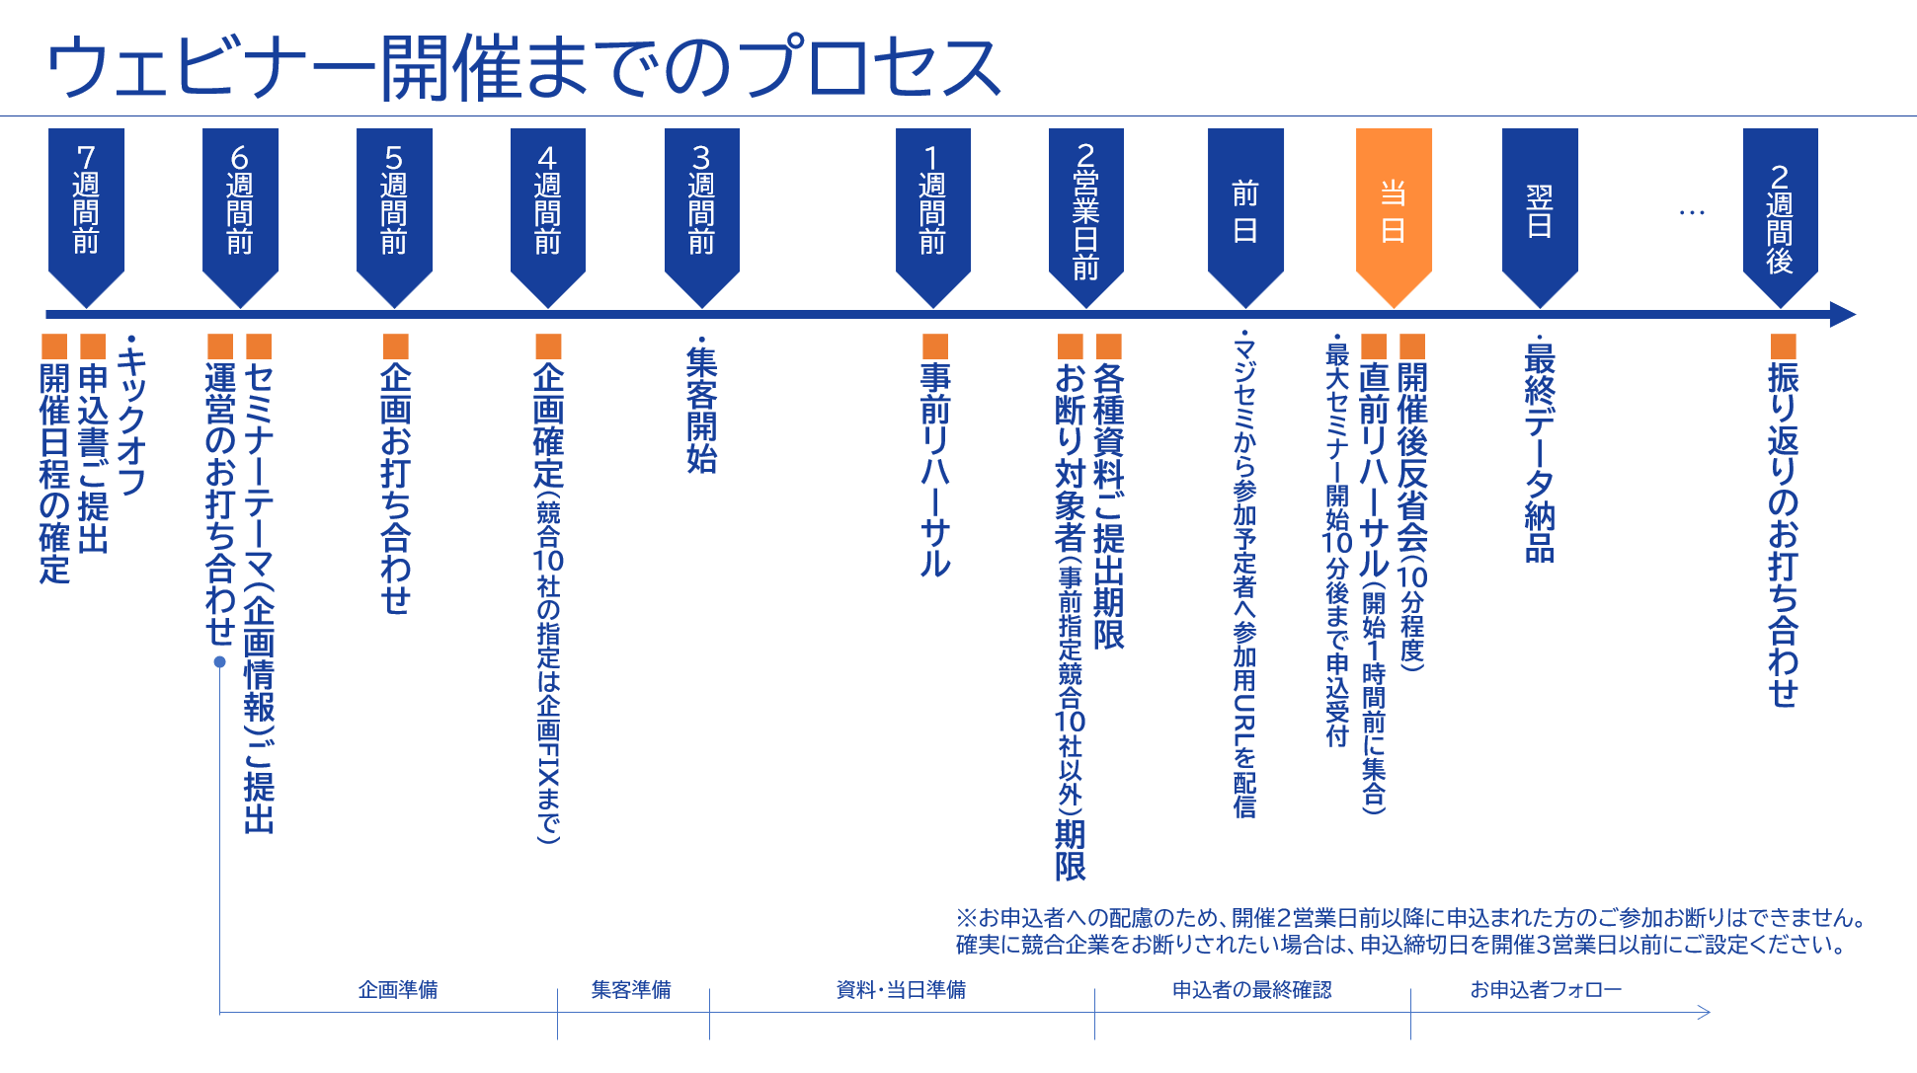
©2018 MAJISEMI Inc.

Slide 31
この機会に、マジセミをスタートしましょう！
マジセミをご利用いただいているクライアント企業様からは
集客もいいし、
商談に繋がっています
認知度が上がり、Webからの
問い合わせも増えました
スタッフ（アテンダント・キャスト）の対応が素晴らしく、
セミナー開催が“楽”になりました
といった声をいただいています。
そしてほとんどのクライアント企業様が、繰り返しマジセミでセミナーを開催しています。
しかし、以下の不安があると思います。
「本当にターゲット企業が来るのだろうか？」
「どのくらいオペレーションが楽になるのだろうか？」
そのようなお客様向けに
「マジセミ倶楽部加入時初回20名無料」キャンペーンをご用意しています。
ぜひマジセミをお試し下さい！
©2018 MAJISEMI Inc.

Slide 32
～後ほどご確認ください～
（ご参考）その他の情報

Slide 33


Reasons to use Majisemi
Webinar
as a Service
Delegate your webinar operations to us
専任の企画担当が、タイトル・告知文を作成します！
Planning
IT知識を有したマジセミの企画専任担当者が、集客と商談化を実現するウェビナー企画を一緒に作り上げていきます。
STEP1
STEP2
STEP3
本申込
商材名・商材情報・ターゲット・ペインポイントを管理システムにご入力いただきます。
Planning meeting
Conduct a one-hour meeting online.
Align details based on preliminary information.
Plan finalized
Press the approval button in the management system to finalize the plan.
弊社にて
Preparation for the launch of the event page
Launch preparation
Starts now!!
メールで
ご確認
アテンダント（セミナー事務局）がウェビナー開催までサポートします！
アテンダント
（セミナー事務局）
年間1000回のセミナー運営経験のあるアテンダントが、セミナー開催まで一緒に伴走致します。
お困りごとは気軽にご相談いただけます！
STEP4
STEP 5
STEP6
On the day
・Moderation
・Collect surveys
Event page launch
Create application page
Handle applicants
・Respond to inquiri es ・Send reminders
・Issue participation URL
Rehearsal
・Confirm the flow and requests for the day ・Check the speaker's connection e nvironment ・Confirm preparation status
Report creation
Cast
Cast
©2018 MAJISEMI Inc.

Slide 34
Reasons to use Majisemi
Webinar
as a Service
Dedicated support from the planning stage
Flow of the planning stage
Preliminary preparation
The planning manager will gather information on the seminar theme shared in advance and create a proposal for appeal points.
Planning meeting
Conduct a meeting for about one hour. Propose appeal points while aligning details.
Create planning proposal
Based on the content aligned in the meeting, the planning manager will create a draft of the title and announcement text.
Submit planning proposal
After creating the planning proposal, the planning manager will submit it via email.
Confirm planning content
Please review the content of the planning proposal and share any feedback if there are any points to address.
Finalize plan
Once the content review and feedback revisions are complete, press the approval button in the management system to finalize the plan.
Preparation for the launch of the event page
Start preparation for launch
©2018 MAJISEMI Inc.

Slide 35
Flow of the event
On the day of the event
Webinar
as a Service
Event time
Distribution tools
General flow of the seminar
Choose from 5 slots
(Weekdays only *No events on weekends and holidays)
1 hour per seminar is the standard
You can choose from 2 types
*We recommend Zoom for its features and delivery quality
*For seminars hosted by Majisemi, an additional fee applies for events longer than 1 hour (150,000 yen/hour)
10:00–11:00
Registration starts
15 minutes
11:00–12:00
Opening
(Majisemi Cast)
Zoom
Teams
13:00–14:00
5 minutes
Lecture
14:00–15:00
30-40 minutes
Poll
15:00-16:00
Q&A
(Navigated by Majisemi Cast)
*On Mondays, only the 14:00 and 15:00 sessions are available
*Majifolo is conducted only at 10:00 and 11:00 sessions
*For seminars targeting the manufacturing industry, to avoid theme overlap, sessions are held at 11:00 and 13:00
10-15 minutes
End
©2018 MAJISEMI Inc.

Slide 36
Reasons to use Majisemi
Webinar
as a Service
コンテンツの有効活用
ブランディング・新規リード獲得
講演内容から記事を作成
自社サイトに登録、SEO対策にも
SEO article
(ブログ)作成
ウェビナー開催時の
コンテンツを再利用して、
開催後も継続して リードナーチャリン グ 新規リード獲得
Distributed later exclusively to absentees
Rebroadcast past Majisemi event videos
Effortless event without on-the-day presentation
ウェビナ ー 開催
Missed broadcast
Rebroadcast
Recorded video
Uploaded to your own website or YouTube
Summary vid eo creation
On your own website or
Posted on your own managed SNS
Webinars or videos other than Majisemi
Secondary use on portals and advertising media
Full vide o provided/free*
Full video p rovided/secondary use*
リードナーチャリング
Listed on majisemi.com
新規リードを獲得
マジセミ倶楽部特典
※トライアルでは無料・有料を問わずフル動画の提供を行っておりません 。 ただし、本契約後はプランを問わず過去のご開催分を提供可能です。
Maji Lead
Document download
©2018 MAJISEMI Inc.

Slide 37
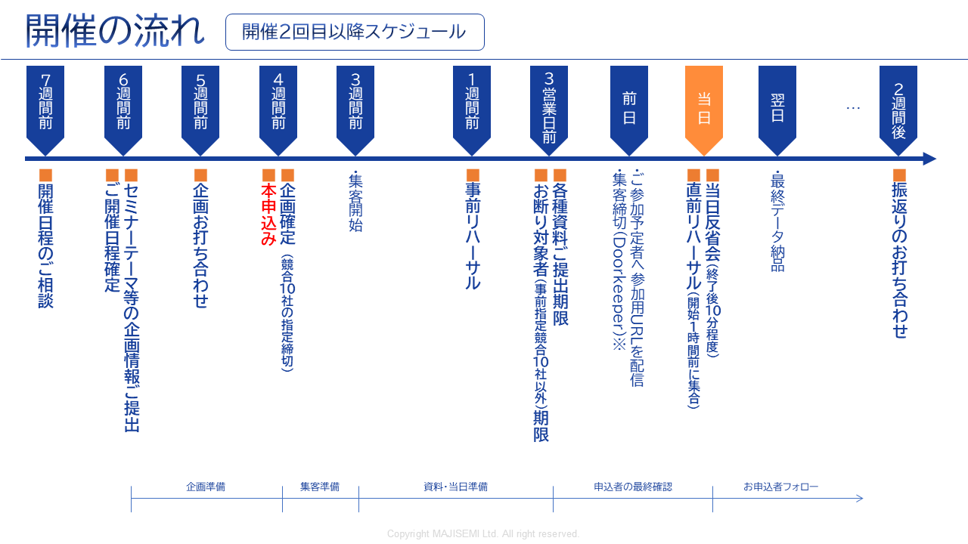
Webinar
as a Service
※お申込者への配慮のため、開催2営業前以降に申込まれた方のご参加お断りはお受けできません。
確実に競合企業をお断りしたい等の場合には、申込締切日を3営業日前にご設定ください。
©2018-2024 MAJISEMI Inc.
©2018 MAJISEMI Inc.

Slide 38
基本プラン
マジセミビジター
Plan Details
Reference Plan
Pricing Plans
単発でウェビナーを開催いただける完全成果報酬型のプランです。
どこまでお任せいただくか4つのタイプからお選びいただけます。
20名からのお申し込みで承ります。
申込が10人しかなかった場合は、10人分のみのご請求となります。
1人申込あたり14,500円(税別)
・ 都度開催、都度申込
・ 集客数による成果報酬型課金
・ 20人以上からの申込
（請求は集客人数分のみ）
※集客人数を正確に把握するため、弊社にてお申込みページを準備し、リストを貴社にご提供いたします。
※実際のご請求は、申込者数に対して上記最大人数までの成果報酬でご請求させていただきます。定員に達した場合、申込受付をストップ致します。
※リストの納品は個人情報保護の観点から、セミナー主催者様に直接納品させていただきます。
※セミナーの参加者だけではなく、欠席者（事前キャンセル、当日キャンセル）についても、ご請求対象となります。
※なるべく上限近く集客できるよう努力いたしますが、集客数を保証するものではありません。
※セミナーのテーマや同時開催の他のイベントなどの影響により、全く集客できないケースもございます。
Management
Management
Menu |  | Planning | Attracting attendees LP Installation | Moderator | Other Media Import | URL Delivery Reminder | Zoom Provision | Post-event Survey
Majisemi Visitor | Standard | ○ | ○ | ○ | No Other Media Posting | ○ | ○ | ○
 | Planning & Customer Acquisition | ○ | ○ | - |  | - | - | -
 | Customer Acquisition & Management | - | ○ | ○ | - | ○ | ○ | ○
 | Customer Acquisition Only | - | ○ | - | - | - | - | -
商品名 | 内容 | 数量 | 単価（￥） | 金額（￥）
マジセミビジター （20名）） | ウェビナーの 企画・集客・運営 | 20 | 14,500 | 290,000
Visitor Plan Reference Plan for 20 People |  | Subtotal |  | 290,000
 |  | Consumption Tax (10%) |  | 29,000
 |  | Total (Including Tax) |  | 319,000
©2018 MAJISEMI Inc.

Slide 39
基本プラン
Majisemi Club Light
Plan Details
Reference Plan
Pricing Plans
Monthly Fee: 120,000 yen (excluding tax) *Includes 10 customer acquisition slots for the Light Plan
Additional Customer Acquisition Slot @10,000 yen (excluding tax)
Automatic renewal every month
10 customer acquisition slots added each month
The minimum capacity for webinars is 30 people
If hosting a webinar with 30 participants in the first month, purchase an additional 20 participant slots (@10,000 yen each)
If the number of participants does not meet the quota, the remaining slots can be carried over to subsequent months
Additional participant slots can be purchased for @10,000 yen
If someone who has registered for your company's past three seminars (subject to charges) registers again for the current seminar, they will not be charged for the current seminar (fan development)
Other benefits include providing leads from those who downloaded publicly available presentation materials, offering a branding dashboard, and providing trend analysis tools
Majisemi Club is a membership service that conducts repeated webinars, implementing PDCA to create better webinars. Membership is subject to screening.
For Majisemi Club, we provide a one-stop service for planning, customer acquisition, moderation, and management. We cannot support customer acquisition only.
Furthermore, the seminar content (planning) will be a 'problem-solving seminar' rather than a 'product introduction'. The product introduction will be conducted in the latter half of the presentation. The seminar content will be decided in consultation with the Majisemi planning members. It may not be possible to hold it on the theme your company desires. If you wish to decide the theme yourself, please use the Visitor Plan.
Please note that considering the purpose of the aforementioned Majisemi Club, a penalty will be set for cancellations within one year from the start of the contract. (The difference from the Visitor Plan fee will be charged)
※集客人数を正確に把握するため、弊社にてお申込みページを準備し、リストを貴社にご提供いたします。
*If the capacity is reached, we will stop accepting applications.
※リストの納品は個人情報保護の観点から、セミナー主催者様に直接納品させていただきます。
*Not only participants but also absentees (cancellations before and on the day) are counted towards the number of attendees.
*The contract is automatically renewed monthly and will continue in the same manner.
*Upon withdrawal, refunds for unused customer acquisition slots cannot be made. Additionally, rejoining the Majisemi Club is not possible for one year after withdrawal.
*Please notify us by email by the end of the month prior to the withdrawal month.
*Benefits are subject to change.
If you face challenges in converting seminars into business discussions or wish to enhance your website content and SEO, please consider our value set plans mentioned later.
商品名 | 内容 | Category | 金額（￥）
Majisemi Club Light (30 participants) | Planning, attracting, and managing webinars | Monthly fee | 120,000
Majisemi Club Light Plan Attracting 30 participants, If 10 participants are attracted through the monthly fee and 20 through additional slots |  | Additional participant slots | 200,000
 |  | Consumption Tax (10%) | 32,000
 |  | Total (Including Tax) | 352,000
©2018 MAJISEMI Inc.

Slide 40
基本プラン
Majisemi Club Light
billing pattern
Pricing Plans
Example of webinar hosting and billing with Majisemi Club
add 10 attendees every month
Webinar
Held
Webinar
Held
Webinar
Held
seminars can be held anytime (or not at all)
(target capacity is 30 or more, rebroadcasts are 10 or more)
Webinar
Held
 | January | February | March | April | May | June | July | August | September | October | November
Additional Attendance Slot | +10 | +10 | +10 | +10 | +10 | +10 | +10 | +10 | +10 | +10 | +10
Beginning of the month Remaining Attendance Slots | 10 | 10 | 20 | 30 | 15 | 10 | 20 | 30 | 40 | 50 | 10
Monthly fee billing | 120,000 yen | 120,000 yen | 120,000 yen | 120,000 yen | 120,000 yen | 120,000 yen | 120,000 yen | 120,000 yen | 120,000 yen | 120,000 yen | 120,000 yen
Seminar held Target capacity | 30 participants |  |  | 30 participants | 50 participants |  |  |  |  | 50 participants
Seminar held Participant achievement | 30 participants |  |  | 25 participants | 48 participants |  |  |  |  | 50 participants
consumption of attendee slots | -10 |  |  | -25 | -15 |  |  |  |  | -50
end of the month Remaining Attendance Slots | 0 | 10 | 20 | 5 | 0 | 10 | 20 | 30 | 40 | 0 | 10
Additional participant slots | 20 |  |  |  | 33
Additional participant slots billing | 200,000 yen |  |  |  | 330,000 yen
target capacity is 30 or more
holding with 50, 100 participants, etc. is OK
seminar with 30 participants from the first month is OK
carry over any shortfall to the next month
any shortfall will be billed at 10,000 yen each
there will be no more than the target capacity
©2018 MAJISEMI Inc.

Slide 41

基本プラン
Majisemi Club Business Negotiation Guarantee
Plan Details
Reference Plan
Pricing Plans
600,000 yen every 3 months (excluding tax)
Contract renewed automatically every 3 months
Guarantee of 30 attendees and 3 business meetings every 3 months
Majifolo included for free
If not achieved, carry over the shortfall to future seminars
For additional events with more than 31 people, 13,500 yen per registration
If someone who has registered for your company's past three seminars (subject to charges) registers again for the current seminar, they will not be charged for the current seminar (fan development)
Other benefits include providing leads from those who downloaded publicly available presentation materials, offering a branding dashboard, and providing trend analysis tools
This is a plan that automatically renews every 3 months. We guarantee 30 attendees and 3 business meetings (appointments).
Our company will handle the planning of seminar content, attracting attendees, managing the day, and sending materials to participants on the day.
Majifolo is included in the fee.
If the initial seminar does not reach 30 people and 3 cases, it will be carried over to that quarter or the next quarter,
We will hold additional seminars. (The basic goal is to achieve it in the first attempt)
*To accurately track the number of attendees, we will prepare the registration page and provide the list to your company.
*If the capacity is reached, we will stop accepting applications.
※リストの納品は個人情報保護の観点から、セミナー主催者様に直接納品させていただきます。
*Not only participants but also absentees (cancellations before and on the day) are counted towards the number of attendees.
*The contract is automatically renewed every three months and will continue thereafter.
*Upon withdrawal, refunds for unused customer acquisition slots cannot be made. Additionally, rejoining the Majisemi Club is not possible for one year after withdrawal.
*To withdraw, please notify us by email by the end of the month prior to the withdrawal month.
*We may not be able to accommodate guarantees with business negotiations.
*Benefits are subject to change.
商品名 | 内容 | 数量 | 単価（￥） | 金額（￥）
Majisemi Club event (30 participants) | Planning, attracting, and managing webinars | 1 | 600,000 | 600,000
Majifolo (30 participants) | Appointment setting via phone and email for participants | 30 | 3,500 | 105,000
 | All cases are free under the Majisemi Club business negotiation guarantee | 30 | -3,500 | -105,000
Majisemi Club Business Negotiation Guarantee Plan Reference plan for 30 participants |  | Subtotal |  | 600,000
 |  | Consumption Tax (10%) |  | 60,000
 |  | Total (Including Tax) |  | 660,000
Guaranteed attendee acquisition and business negotiations!
©2018-2023 MAJISEMI Inc.

Slide 42
マジセミ倶楽部のお得なプラン（改定予定）
Pricing Plans
Recommended
 |  | ライト | シルバー | ゴールド | プラチナ | プレミアム
付属サ|ビス | Webinar hosting | ● | ● | ● | ● | ●
 | SEO article creation | ― | ●※1 | ― | ― | ●※1
 | マジフォロ | ― | ― | ●※2 | ●※2 | ●※2
 | マジフォロプラス | ― | ― | ― | ●※3 | ●※3
 | サマリ動画 | ― | ― | ― | ― | ●※1
追加集客枠プレゼント （特典）※４ |  | ― | 毎年10人分 10万円相当 | 毎年20人分 20万円相当 | 毎年40人分 40万円相当 | 毎年80人分 80万円相当
Monthly fee |  | 120,000 yen | 13.5万円 | 15.5万円 | 25.5万円 | 38.5万円
シンプルにウェビナー
開催だけ依頼したい
講演内容を
Webサイトにも活用したい
ウェビナー開催直後に
フォローしたい
ウェビナーから確実に
商談につなげたい
ウェビナーの効果を
最大化したい
※１ SEO記事作成、サマリ動画作成は、年4回まで実施可能です。また、別途オプションとして購入いただくことでそれ以上も実施可能です。
※２ マジフォロは年120人分まで実施可能です。また、別途オプションとして購入いただくことでそれ以上も実施可能です。
※３ マジフォロプラスの毎月の活動費用を含んでいます。アポ獲得時の成果報酬（1アポ3万円）が別途かかります。
※４ 追加集客枠プレゼント特典は、マジセミ倶楽部にご加入いただいてから1年後に付与され、以降毎年同月に付与されます。
(金額は全て税別です)
©2018 MAJISEMI Inc.

Slide 43
Other options *Please consult with us for details
Webinar
as a Service
Name | Price (excluding tax) | 内容
マジフォロ (Post-seminar follow-up) | @3,500 yen × number of attendees | Majisemi's follow-up specialist staff will follow up with participants and absentees via email and phone immediately after the seminar ends.
SEO article creation | 50,000 yen | We will create an article of about 3,000 characters with SEO in mind based on the seminar content. By publishing it on your website, you can promote content marketing.
Full video provision/paid | 200,000 yen | This is an option to provide seminar videos for secondary use. *We offer it for free within certain usage limits. During the trial, neither paid nor free provision is available.
Summary video creation | 50,000 yen | When posting seminar videos on YouTube, etc., long videos tend to be disliked. Therefore, we will edit and provide them in about 5 to 10 minutes.
Missed broadcast | 50,000 yen | For those who registered for the seminar but were absent on the day, we will allow them to view the day's video.
Rebroadcast | @14,500 yen/10,000 yen | Using recordings from past Majisemi events, we will hold additional webinars without hassle.
Two-step webinar | 200,000 yen | We will plan and hold a theme that leads to more business discussions (appointments) for those who have previously registered for your webinars (your prospective customers), such as competitor comparisons, product introductions, demos, etc.
Operational support (operation outsourcing) | 200,000 yen | We will handle the operation of your seminar. We will take care of tasks such as creating the registration page, managing registrants, lending Zoom, and moderating on the day. (Attracting attendees is not included. Please handle it yourself.)
By Majisemi representative Terada Presentation at your seminar | 300,000 yen～ *About 30 minutes to 1 hour | Majisemi representative Terada will facilitate presentations, discussions, and panel discussions at your seminar. Please consult us about the theme.
"Evangelist AI" Digital Terada's keynote speech outsourcing | 100,000 yen | "Evangelist AI" Digital Terada, utilizing generative AI, will deliver a keynote speech at your webinar. - Want to give a seminar presentation but don't have time to create the script and slides - No skilled presenters among employees (or they are busy), so want to outsource the presentation as well
SEO Video Creation | 50,000 yen per video～ *In units of 10, excluding initial costs | This is a strategy to aim for top rankings in YouTube searches and Google video searches. Majisemi will create a custom AI avatar for your company and produce video content explaining terms. Scripts can also be delivered, and blog utilization is possible.
Product comparison video creation | 500,000 yen～ *Excluding initial costs | We will create a competitive product comparison video to strongly recognize the strengths of your product. Majisemi will create a custom AI avatar for your company and produce product comparison video content. It can also be distributed in webinars.
©2018 MAJISEMI Inc.

Slide 44
Notes
Webinar
as a Service
■ Basically, meetings start six weeks in advance, and the formal application is made four weeks before the event.
Additional charges
Cancellation fee
For all services, if you cancel after making a 'formal application' through Majikan (Majisemi management screen) or after we receive the order form/application form, a 100% cancellation fee will apply.
However, for webinar events, the cancellation fee is capped at 20 attendees for visitors and 30 attendees for Majisemi Club.
For Majifolo, the cancellation fee is capped at 20 attendees for visitors and 30 attendees for Majisemi Club.
If adjustments to the title, announcement text, etc., are delayed and the webinar cannot be published by 5 PM, 10 business days before the event date, it will be treated as a cancellation and the above cancellation fee will be charged.
No refunds will be given for remaining attendee slots upon withdrawal from Majisemi Club.
Considering the purpose of Majisemi Club, a penalty is set for cancellations within one year from the start of the Majisemi Club contract. Please understand. (We will charge the difference from the visitor fee)
マジセミビジター
Orders placed after four weeks before the event will incur a surcharge.
 | Unit price (excluding tax) | Upper limit specified
Basic fee (Order placed more than four weeks before the event) | 14,500 yen | More than 20 attendees
Order placed after four weeks before the event | ×1.25 times surcharge
Order placed after three weeks before the event | ×2 times surcharge
Various Majisemi Club
If the formal application cannot be completed four weeks before the event, there is no surcharge, but we will postpone the event after consultation.
©2018 MAJISEMI Inc.

Slide 45
Majisemi Inc.

Slide 46

Company name
Head office location
Representative name
Business activities
Seminar hosting achievements
Established
Capital
Number of employees
Majisemi Inc.
3rd Floor, Shiodome Building, 1-2-20 Kaiga n, Minato-ku, Tokyo 105-0022 Yuichi Terada
Operation of the IT and manufacturing industry specialized seminar marketing service 'Majisemi'
Last year's achievements: approximately 1,000 events held, total attendance approximately 60,000 people (2023)
January 2018
10 million yen
45 employees
About Us
Company overview
Creating opportunities for new encounters and experiences with digital-related products and services to promote the development of domestic industries and the advancement of engineers.
To achieve this, we convey the potential and excellence of technology widely to society, regardless of the size of the providing company.
We clearly communicate to end-users not the technology itself, but how it can solve their problems.
By 2025, we aim to host 2,000 webinars annually.
MISSION
セミナーをエンタメに変える
セミナーで社会を変える
おかげ様で３つのNo.１
獲得しました！1
集客に強いセミナーNo.1
IT責任者が
選ぶセミナー
No.1
新規の商談獲得に
強いセミナー
No.1
©2018 MAJISEMI Inc.
日本マーケティングリサーチ機構調べ調査概要:2021年サービスの比較印象調査

Slide 47
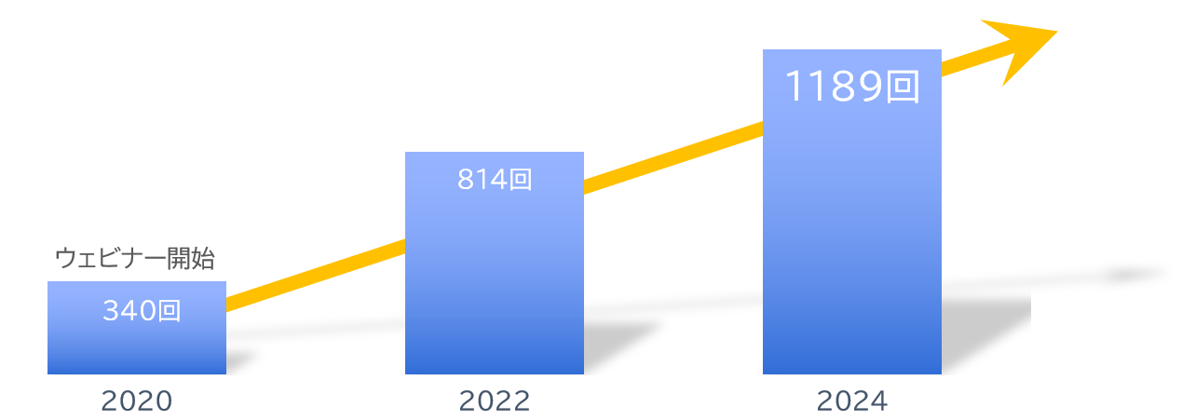
About Us
With clients
Number of seminars held
Increasing every year!
A10ネットワークス株式会社
アイテック阪急阪神株式会社
アドバンテック株式会社
株式会社アクシオ
株式会社アシスト
伊藤忠テクノソリューションズ株式会社
株式会社インターネットイニシアティブ
インフォコム株式会社
エクイニクス・ジャパン株式会社
SCSK株式会社
エフセキュア株式会社
エムオーテックス株式会社
エンカレッジ・テクノロジ株式会社
エントラストジャパン株式会社
株式会社オージス総研
株式会社オプロ
クリックテック・ジャパン株式会社
クロス・ヘッド株式会社
KCCSモバイルエンジニアリング株式会社
株式会社サーバーワークス
サイオステクノロジー株式会社
サイバートラスト株式会社
株式会社ジール
CTCシステムマネジメント株式会社
株式会社システナ
シンガポールテレコム・ジャパン株式会社
GMOグローバルサイン株式会社
JBサービス株式会社
スターティアレイズ株式会社
Smart Style Co., Ltd.
Sumitomo Electric Information Systems Co., Ltd.
Zoho Japan Corporation
Soliton Systems K.K.
Dynatrace
TIS Inc.
Techvan Co., Ltd.
TechMatrix Corporation
Delivery Consulting Inc.
Dell EMC
NSW Inc.
HULINKS Inc.
Netskope Japan Co., Ltd.
Pasona Tech, Inc.
Nippon Telegraph and Telephone East Corporation
Fujitsu Limited
Fujitsu Communication Services Limited
Fuji Electric IT Solutions Co., Ltd.
Mitsubishi Electric Information Systems Corporation
Mirantis Japan, Inc.
Monstar Lab, Inc.
Red Team Technologies Inc.
Rosetta Corporation
(Agent)
MM Research Institute Ltd.
Creative Bank Inc.
Target Media Co., Ltd.
Nikkei Advertising Inc.
Bigbeat Inc.
Mynavi Corporation
取引実績
Major clients only, in alphabetical order
©2018 MAJISEMI Inc.

Slide 48
集客に強いセミナーNo.1
No.1 seminar for acquiring new business negotiations
No.1 seminar chosen by IT managers
Survey by Japan Marketing Research Organization Overview: 2021 Service Comparison Impression Survey
セミナーをエンタメに変える
セミナーで社会を変える

